Slide 1
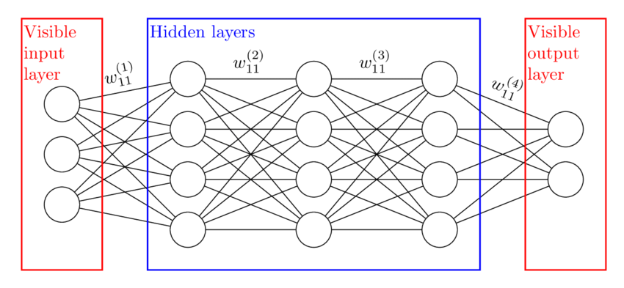
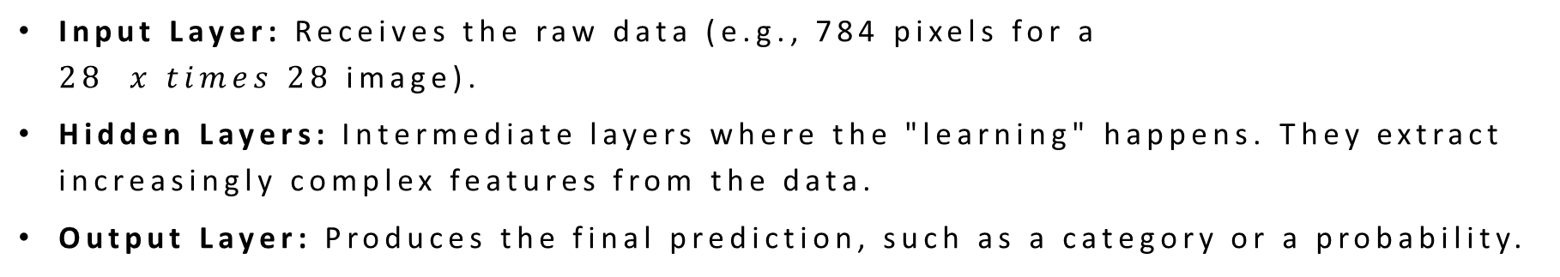
Designing the Network: Input, Hidden, and Output Layers
Input Layer: Receives the raw data (e.g., 784 pixels for a $28 x times 28$image).
Hidden Layers: Intermediate layers where the "learning" happens. They extract increasingly complex features from the data.
Output Layer: Produces the final prediction, such as a category or a probability.

Slide 2
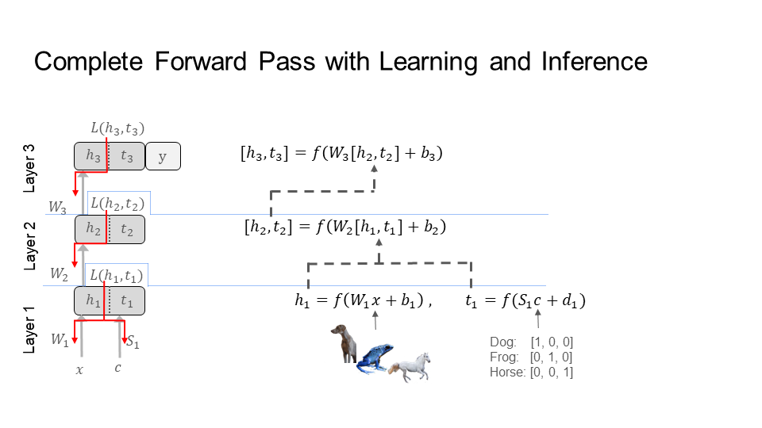

The Forward Pass: From Data to Decision
Data flows in one direction: from input to output.
Each layer calculates $z = W.cdot x + b$, then applies an activation function.
The final output is the network’s "guess" or raw score (logit).

Slide 3
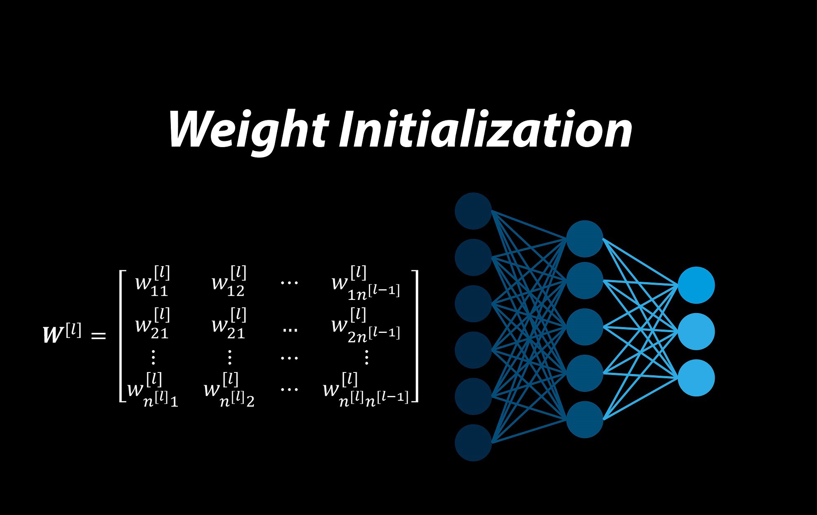

Weight Initialization: Setting the Stage for Success
Initializing weights to zero prevents learning because neurons remain symmetric.
Xavier (Glorot) Initialization: Best for Sigmoid or Tanh activations; it keeps the variance of the signals constant across layers.
He Initialization: Optimized for ReLU activations; it uses a larger variance($\sqrt{2}/n$)to prevent the signal from dying out in deep networks.

